Slide 1
Fulbright Scholarship
Ray Cadmore
Professional Scholar (Vocational Education & Training)
18 September 2014

Slide 2






Slide 3

Senator J. William Fulbright
Post WW2
Was the first Treaty ever signed between Australia and the USA
Is in it’s 65th Year
Under the auspice of the US Dept. of State

Slide 4

About Ray Cadmore
Teacher/Project Officer
  Land and Environment/National Centre for Sustainability
Background in Navy (Survey) and Dairy Technology
Masters Degree in Professional Education and Training
Sunraysia Institute of TAFE (Technical and Further Education)

Slide 5
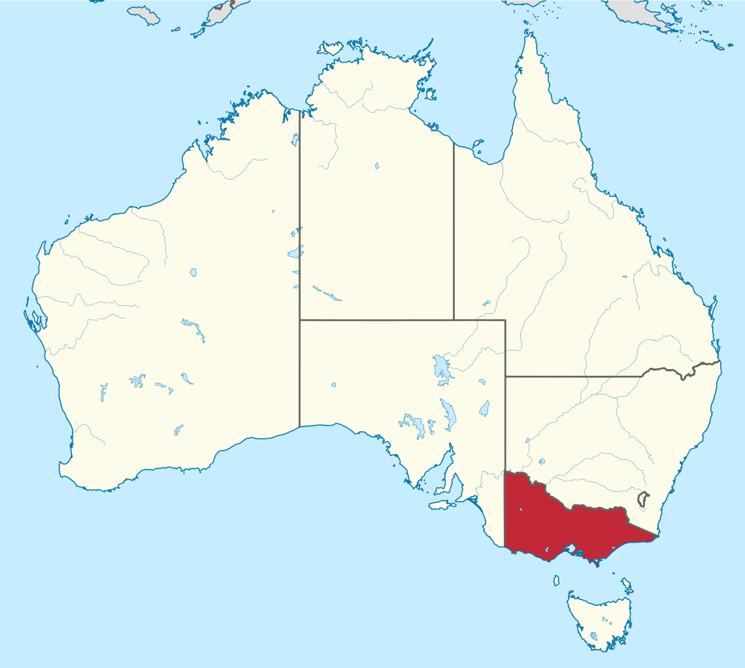

Slide 6
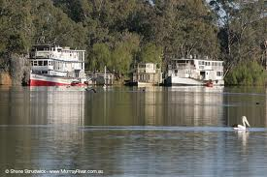

Slide 7
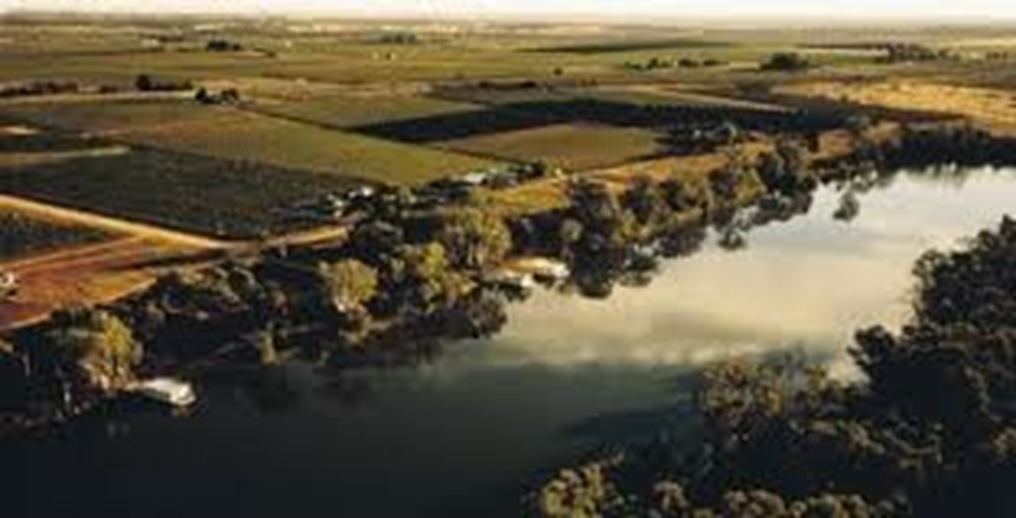
Thefithestate.com.au

Slide 8
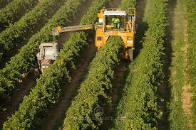

Slide 9

(Silex) Solar Systems-customised training at Mildura, Victoria, Australia.photo courtesy Solar Systems Ltd

Slide 10
Integration of Emerging Technology into Community College Curriculum

Slide 11
The question
How do community colleges, industry, government, universities work together to engage in new and emerging technologies?

Slide 12
Structural change……….
Demise of many traditional industries
  General manufacturing-white goods-consumer items
  Australian car industry shutdown
  Drought-climate change

Slide 13
Manufacturing benefits
Income $102,146 million value adding
Jobs 923,000 jobs
R&D manufacturing spends 4.5 billion p.a.
Skills

Slide 14
But….new markets are being developed
Agri-foods sector
Textiles
Machine/tools

Slide 15
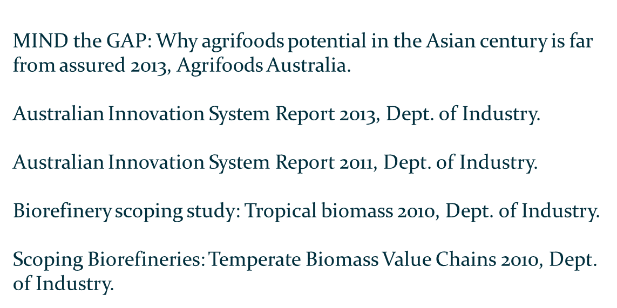
Australian Government Reports

Slide 16



Explore the US experience
What new skills for new technologies?

Slide 17
Why North Carolina?
Tobacco
Textiles
Furniture

Slide 18

North Carolina
Decided 30 years ago to pursue Bio Tech and Pharmaceutical
3rd largest hub in the US
Has developed a supportive structure
Good wages and good job prospects
Leveraged into 2nd and 3rd generation “new technologies” such as advanced manufacturing

Slide 19
NC BioTechnology Center
NC Ag Bio
NC Community College System
BioNetwork
BTEC (NC State)
BRITE (NCCU)

Slide 20
Forsyth Tech
National Center for the Biotechnology Workforce
  Is the lead agency of a national program to develop better education and training outcomes for the life sciences field.
  Federal Dept. of Labor/National Science Foundation funded national consortium of 12 community colleges

Slide 21
Bioscience Industry Fellowship (NSF-ATE sponsored)
Customised training
Customised curriculum
Generic “core” curriculum
National networks and collaborations
  Consortium for Bioscience Credentials (C3BC)

Slide 22
Doing things well creates interest
Legislators
Corporates
  Other industries
Educators
Economic and workforce developers
Interest creates more opportunities

Slide 23
Life cycle of the start up
Early collaborations – identify barriers and promise
Workforce/economic developers: Regional-State
Research organisations (Universities)
Teaching organisations (Community Colleges)
Training Effort
  Initially- soft skills: governance, structures, business plan development (College & University effort)
  may be 5+ years before workforce expansion and direct Community College effort for line skills

Slide 24

Thank you for your interest.
My contact details are:
Ray Cadmore
Sunraysia Institute of TAFE
Mildura, 3500
Victoria, Australia.
rcadmore@sunitafe.edu.au
rcadmore@bigpond.net.au
wikipedia

